Slide 1
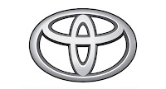
Toyota’s Fuel Economy Analysis Platform: ToyotaEco

Slide 2
Table of Contents:
Team Introduction | Get introduced to the team of developers who have worked on creating this solution!
Challenge Overview | Review the problem statement for which we have created a possible solution!
Importance of the Problem | Discuss why this problem is crucial to address.
Proposed Solution Presentation | Present the solution we have prepared to address and solve this problem!
Key Function and Features | Dive deep into the functions of this solution, and the different features this tool offers!
Impact of the Solution | Go over the impact which this proposed solution can have on the targeted domain.

Slide 3
Our Team:
Suchi Jain
Eshann Saxena
Pankti Mevada
Amulya Suravarjhula

Slide 4
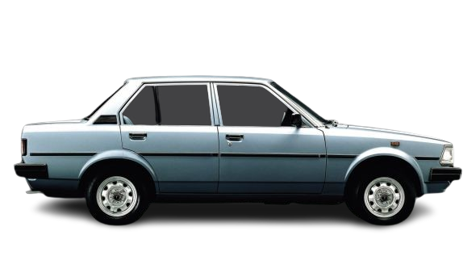
Challenge Overview
Toyota employees need an easy-to-use app to analyze vehicle fuel economy data for the years 2021-2025. The goal is to identify trends, insights, and relationships within the data to support decision making and innovation.

Slide 5
Importance of the Problem
Environmental sustainability: Fuel efficiency directly impacts carbon footprints
Regulatory Compliance: Adhering to strict fuel economy standards avoids penalties
Customer Demand: Enhancing fuel efficiency meets consumer expectations
Strategic Decision Making: Analyzing trends enables innovative design and production
Brand Reputation: Maintaining a lead in producing the most fuel-efficient vehicles on the market

Slide 6
Proposed Solution:
The solution is an app that enables Toyota employees to:
Developed using Python and Streamlit
Incorporate data visualization libraries: Matplotlib, Seaborn, Plotly
Allows real-time data filtering and analysis

Slide 7
Key Features:
Data loading and preprocessing
Interactive visualizations
Time series analysis
Vehicle type analysis
Custom analysis options

Slide 8
Impact of the Solution:

Slide 9
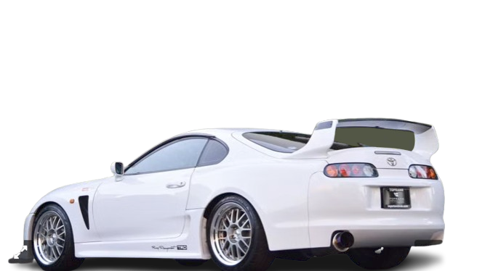
With the data being collected and analyzed...
Toyota employees can make data-driven decisions that enhance product design, support innovation, and maintain Toyota’s competitive edge in the automotive industry.

Slide 10
Conclusion and Insights:
Averages
Trends
Standouts
There has been a consistent upward trend in the fuel economies from 2021 to 2025
The mileages of gasoline and electric combined cars are significantly higher than their single fuel type counterparts
The year with the greatest number of car models is 2024, and said cars showed great improvement in overall mileage of all models.

